Slide 1
Customer Retention project
E-retail factors for customer activation and retention

Slide 2
Introduction
Customer satisfaction has emerged as one of the most important factors that guarantee the success of online store; it has been posited as a key stimulant of purchase, repurchase intentions and customer loyalty. A comprehensive review of the literature, theories and models have been carried out to propose the models for customer activation and customer retention. Five major factors that contributed to the success of an e-commerce store have been identified as: service quality, system quality, information quality, trust and net benefit. The research furthermore investigated the factors that influence the online customers repeat purchase intention. The combination of both utilitarian value and hedonistic values are needed to affect the repeat purchase intention (loyalty) positively. The data is collected from the Indian online shoppers. Results indicate the e-retail success factors, which are very much critical for customer satisfaction.

Slide 3
Contents :-
Problem Statement
Customer Retention and its benefits
Reasons why retention is the foundation of customer growth
Problem Understanding
Importing Libraries
Loading Dataset
Exploratory Data Analysis
Graphical Visualization
Processing the dataset
Correlation
Conclusion

Slide 4
Problem Statement
Customer satisfaction has emerged as one of the most important factors that guarantee the success of online store; it has been posited as a key stimulant of purchase, repurchase intentions and customer loyalty. A comprehensive review of the literature, theories and models have been carried out to propose the models for customer activation and customer retention. Five major factors that contributed to the success of an e-commerce store have been identified as: service quality, system quality, information quality, trust and net benefit. The research furthermore investigated the factors that influence the online customers repeat purchase intention. The combination of both utilitarian value and hedonistic values are needed to affect the repeat purchase intention (loyalty) positively
Data Scientists have to apply their analytical skills to give findings and conclusions in detailed data analysis written in jupyter notebook Only data analysis is required.

Slide 5
Customer Retention and It’s Benefits
Customer retention refers to the activities and actions companies and organizations take to reduce the number of customer defections.
It is important to remember that customer retention begins with the first contact a customer has with a company and continues throughout the entire lifetime of the relationship
There are a number of actions and activities certain companies take to reduce churn and increase customer retention.
Focusing on customer retention is important because it not only looks at how good a company is at acquiring new customers but also how good they are at keeping those customers. While you may have the best acquisition process in the business, if your retention is terrible then it’s all worthless

Slide 6
Benefits
Loyal Customers are More Profitable
You’ll Earn More Word of Mouth Referrals
Loyal Customers are More Forgiving
Customers Will Welcome Your Marketing
Retention is Cheaper than Acquisition
Customers Will Explore Your Brand

Slide 7
Problem Understanding
Customer retention means the process of maintaining or keeping customers once you have acquired them. It’s all the activities that a company must do in order to keep their customers around. The goal is to build a long-lasting relationship between the brand and consumers. Once a customer becomes loyal to your brand, not only he will buy more from you than a normal customer but he’ll spread good words about your business, increase your reputation. Here we have to analyse the affect of different feature on customer retention.

Slide 8
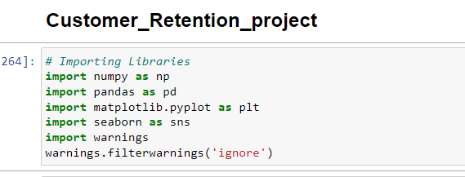
Importing Libraries

Slide 9
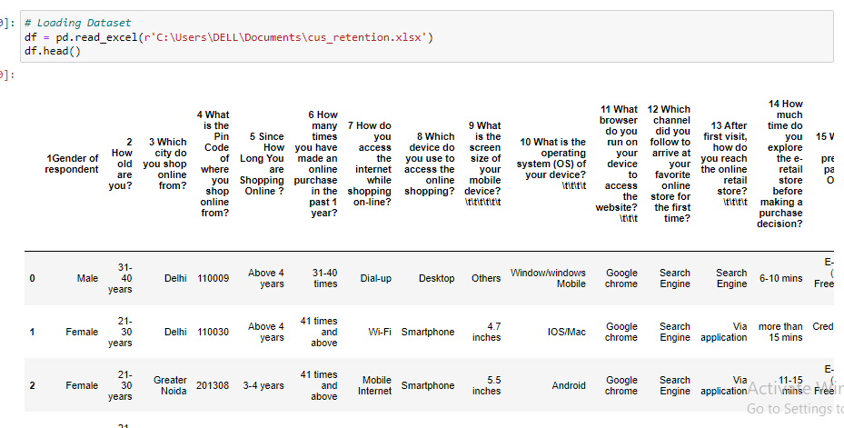
Loading Dataset

Slide 10
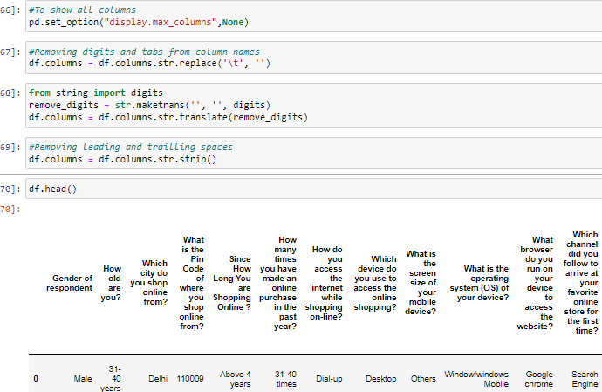
Dealing with columns

Slide 11
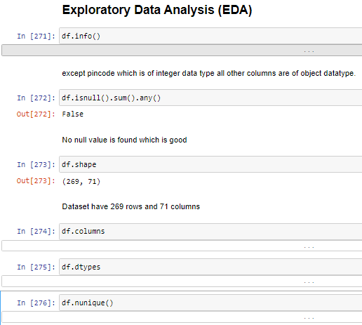
Exploratory Data Analysis

Slide 12
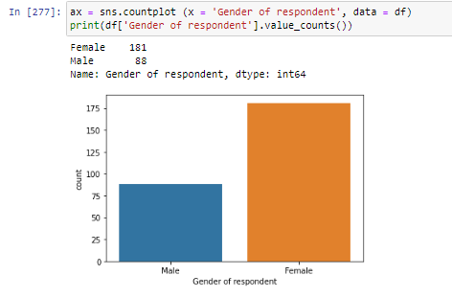
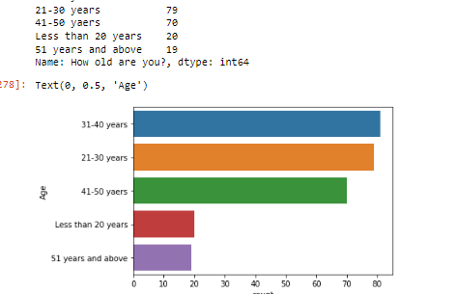
Visualization

Slide 13
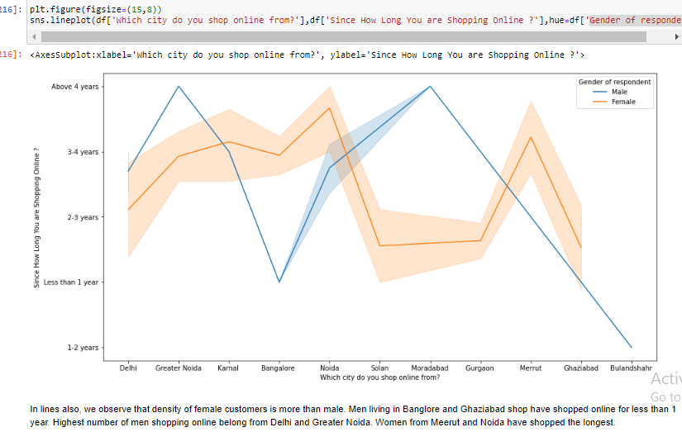

Slide 14
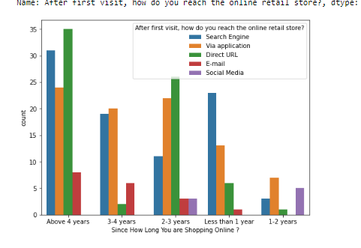
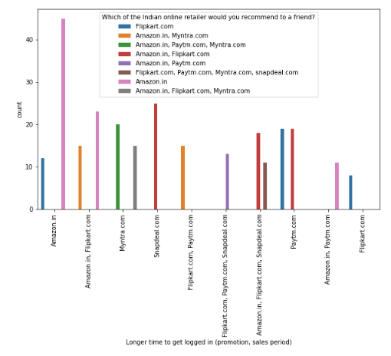

Slide 15
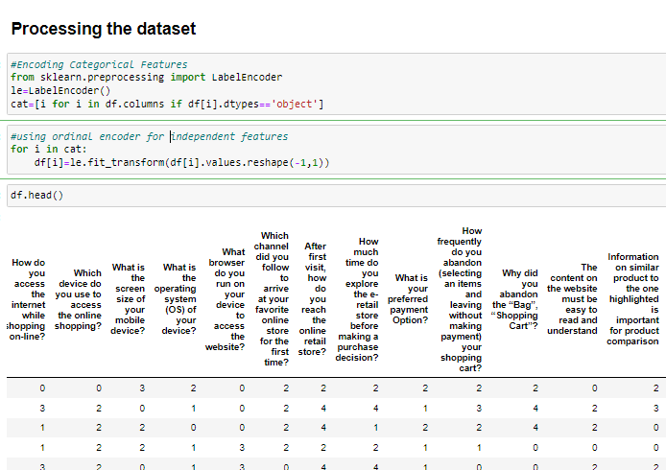
Processing the Dataset

Slide 16
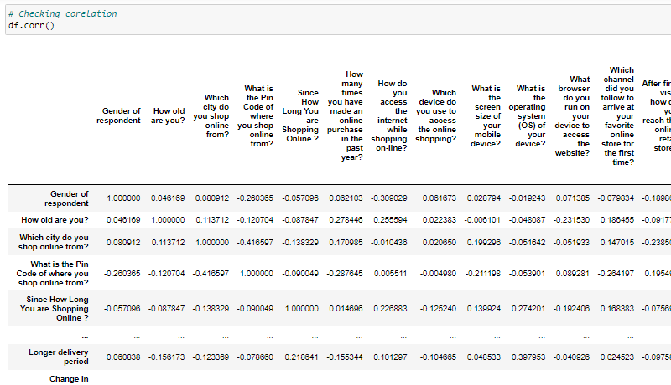
Correlation

Slide 17
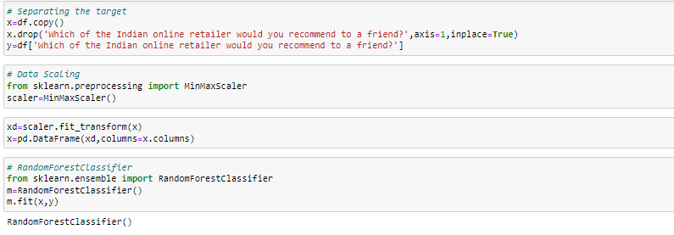

Slide 18
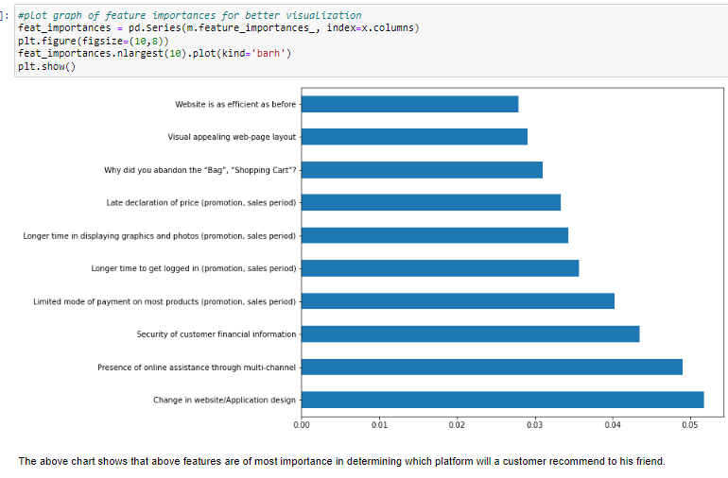

Slide 19
Important Factors of Customer Retention :-
Discounts and Monetary Benefits
Value for the money spent
Relevant information on all the products
User friendly Interface
Trust and On-Time Delivery.
Flexibility in their offers and services
Convenience in payment methods
Secure and offers complete privacy to their customers
Wide range of options and product selections
Quality information on websites
Website Quality
Easier website design and navigation
Easy to read and understandable content
Better Customer Service

Slide 20
Conclusion
Amazon and Flip kart are standing best out in the market by using ethical, reasonable business strategies.
Loyal customers prefer buying and tend to spend more money on shopping in same store.
When customers are satisfied with a company or service, there is a high possibility that they will share their experience with other people.
Frequency of Females shopping is high so making them satisfied will help to get more business.

Slide 21
Conclusion
Statistics show that engaged consumers purchase more frequently.
It is necessary to hear customer feedback because most of them are valuable feedbacks.
Also Paytm and Snap deal has maximum drawbacks it is because of their old strategies.

Slide 22

Submitted By – Smita More

